Slide 1


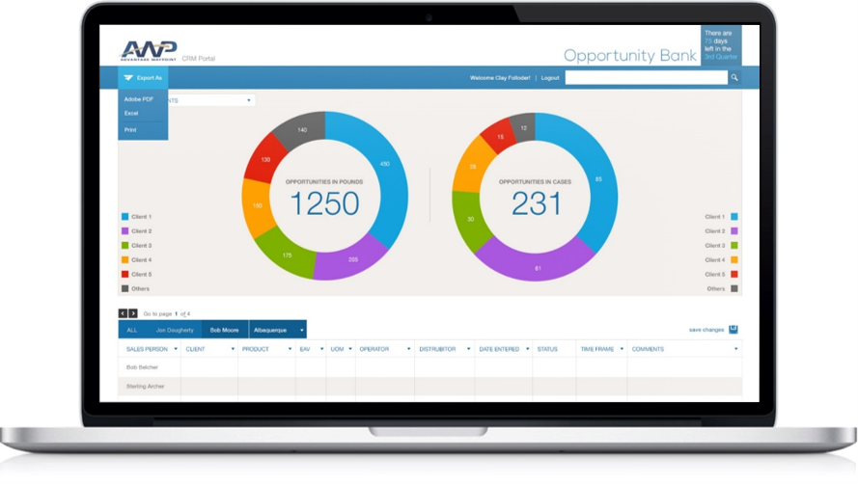
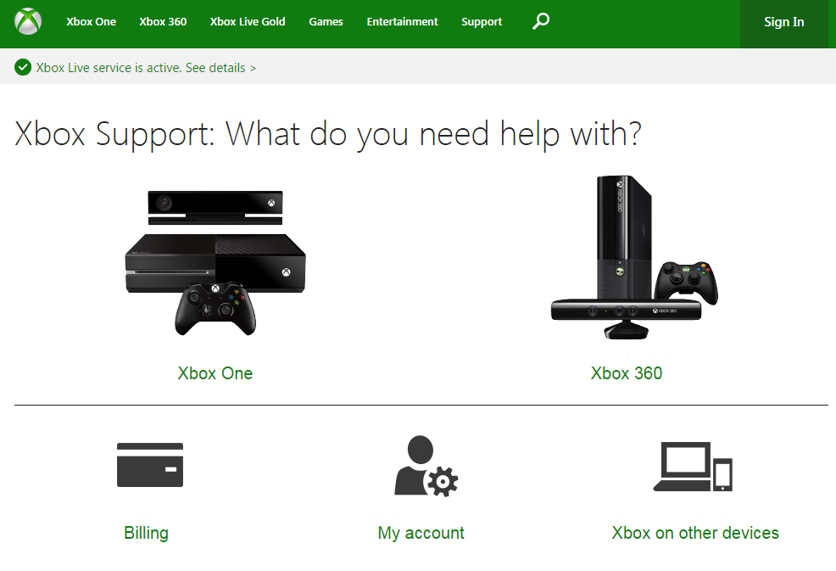
Microsoft - Support.Xbox.com Migration
Business Need
Support.Xbox.com provides a self-service support platform for customers who are having issues with their consoles, need to update billing information or want to manage their accounts.
Microsoft needed to migrate their existing support site away from a custom CMS platform in an extremely condensed timeframe.
What We Did
Affirma was engaged to take the existing site design and migrate it into a new CMS platform in a very compressed project schedule.
We created the new master pages, templates, content types, web parts, and pages necessary for the new site, migrated all content and deployed the application.
Support.Xbox.com is now live and localized into over 40 languages. Feedback from users has been extremely positive. The project was launched on-time and under budget.

